Slide 1

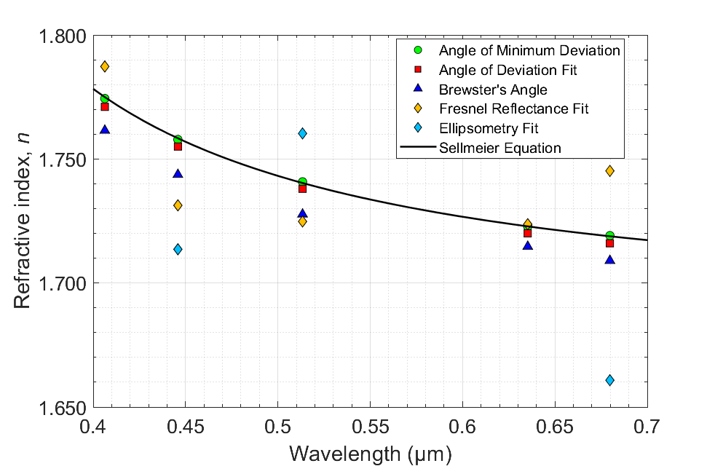
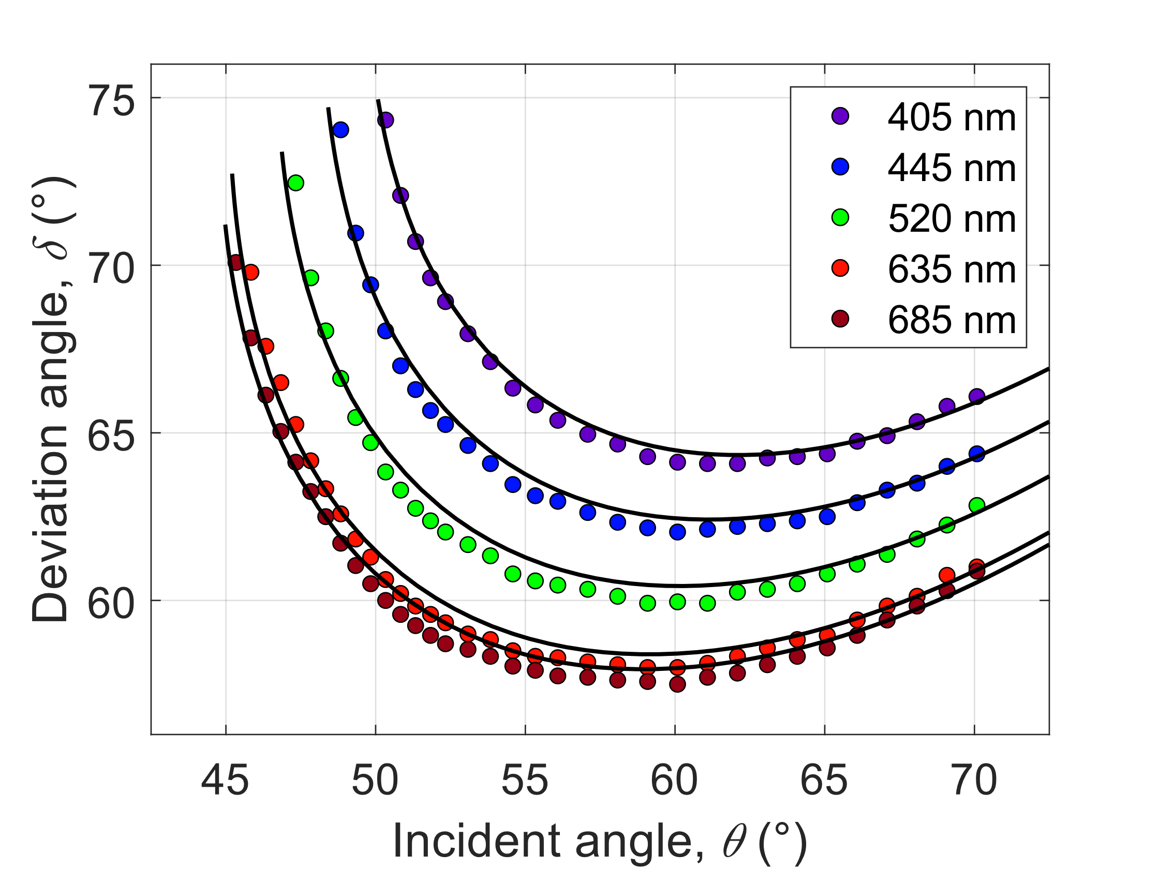
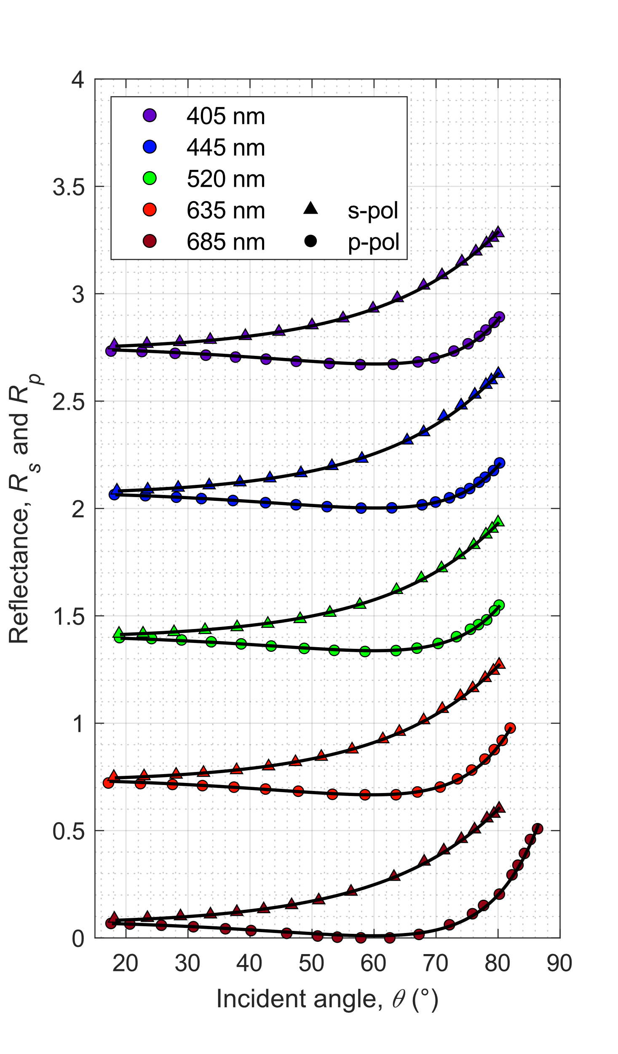
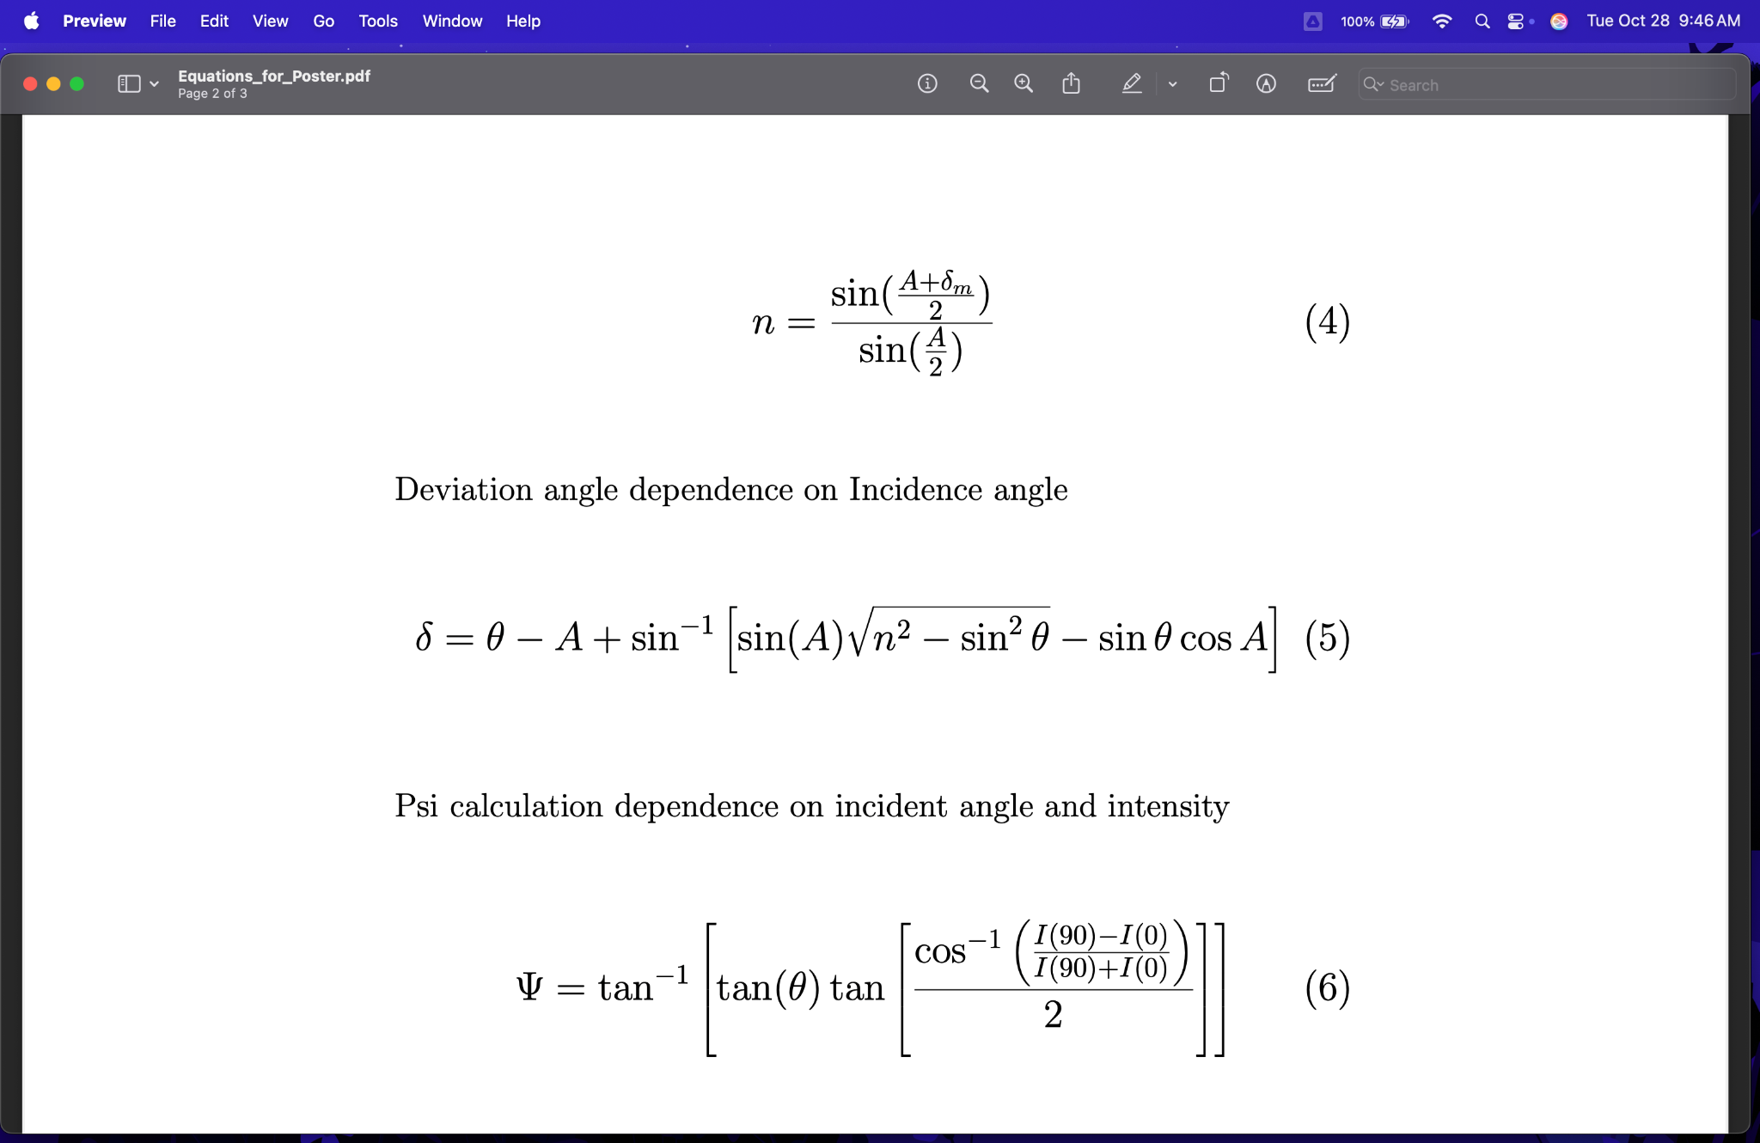
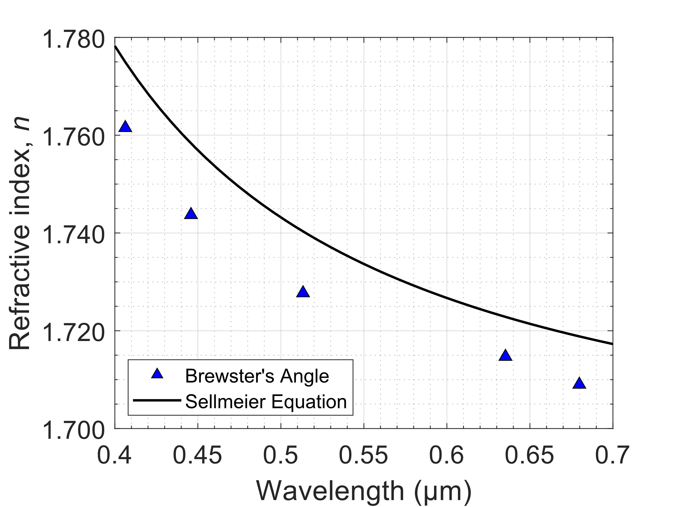
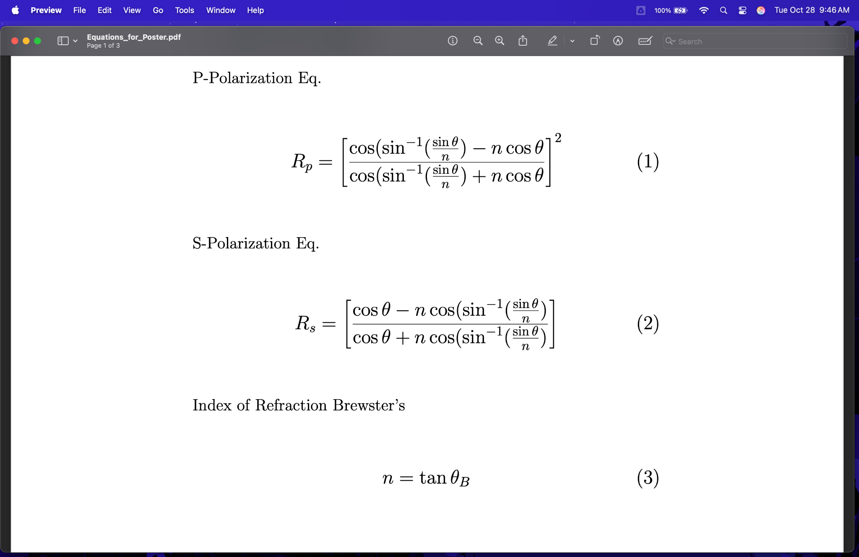
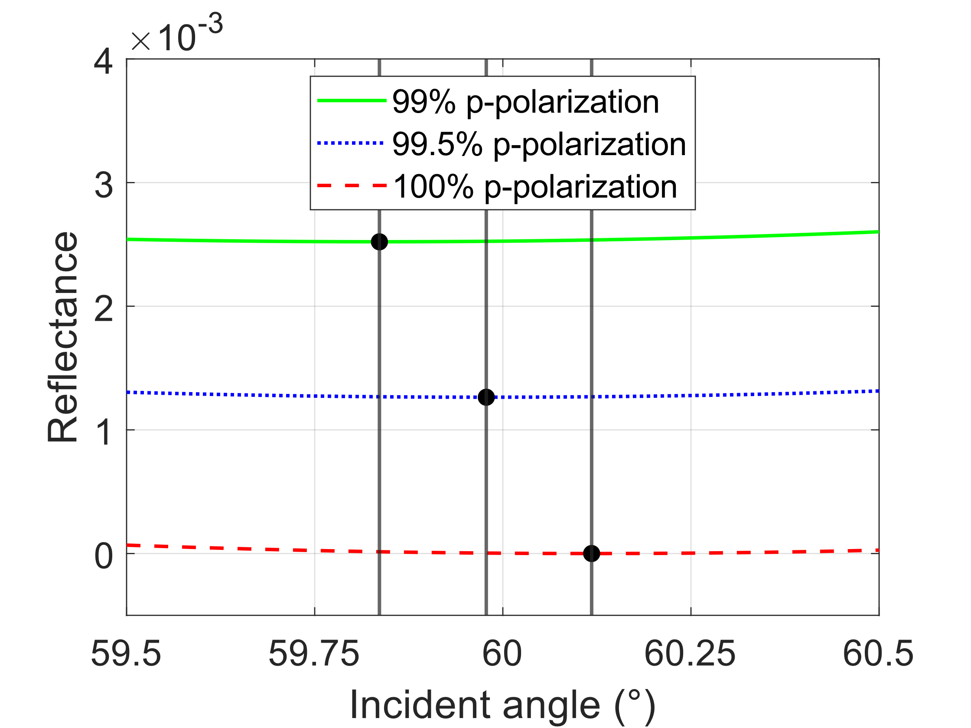
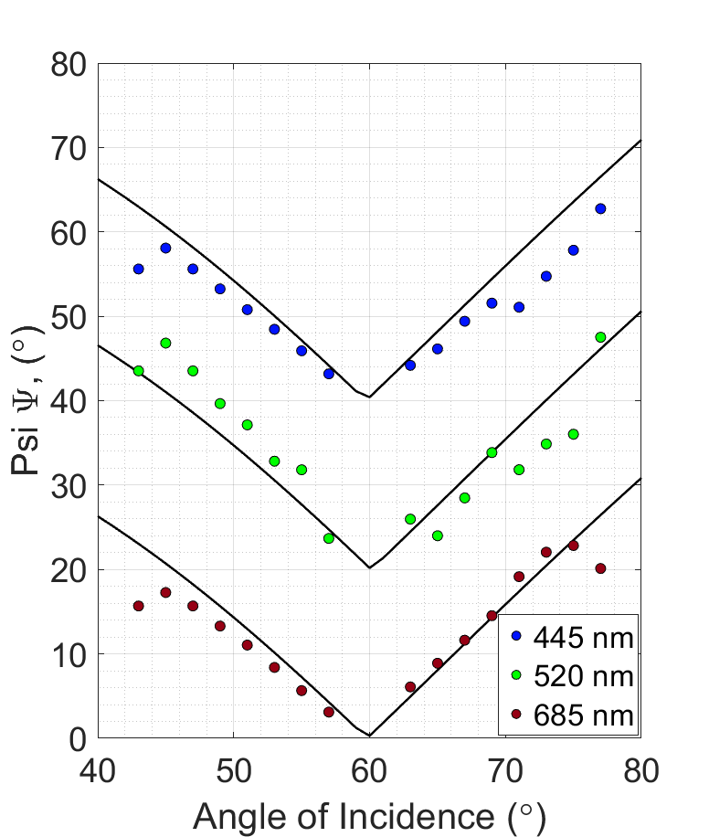
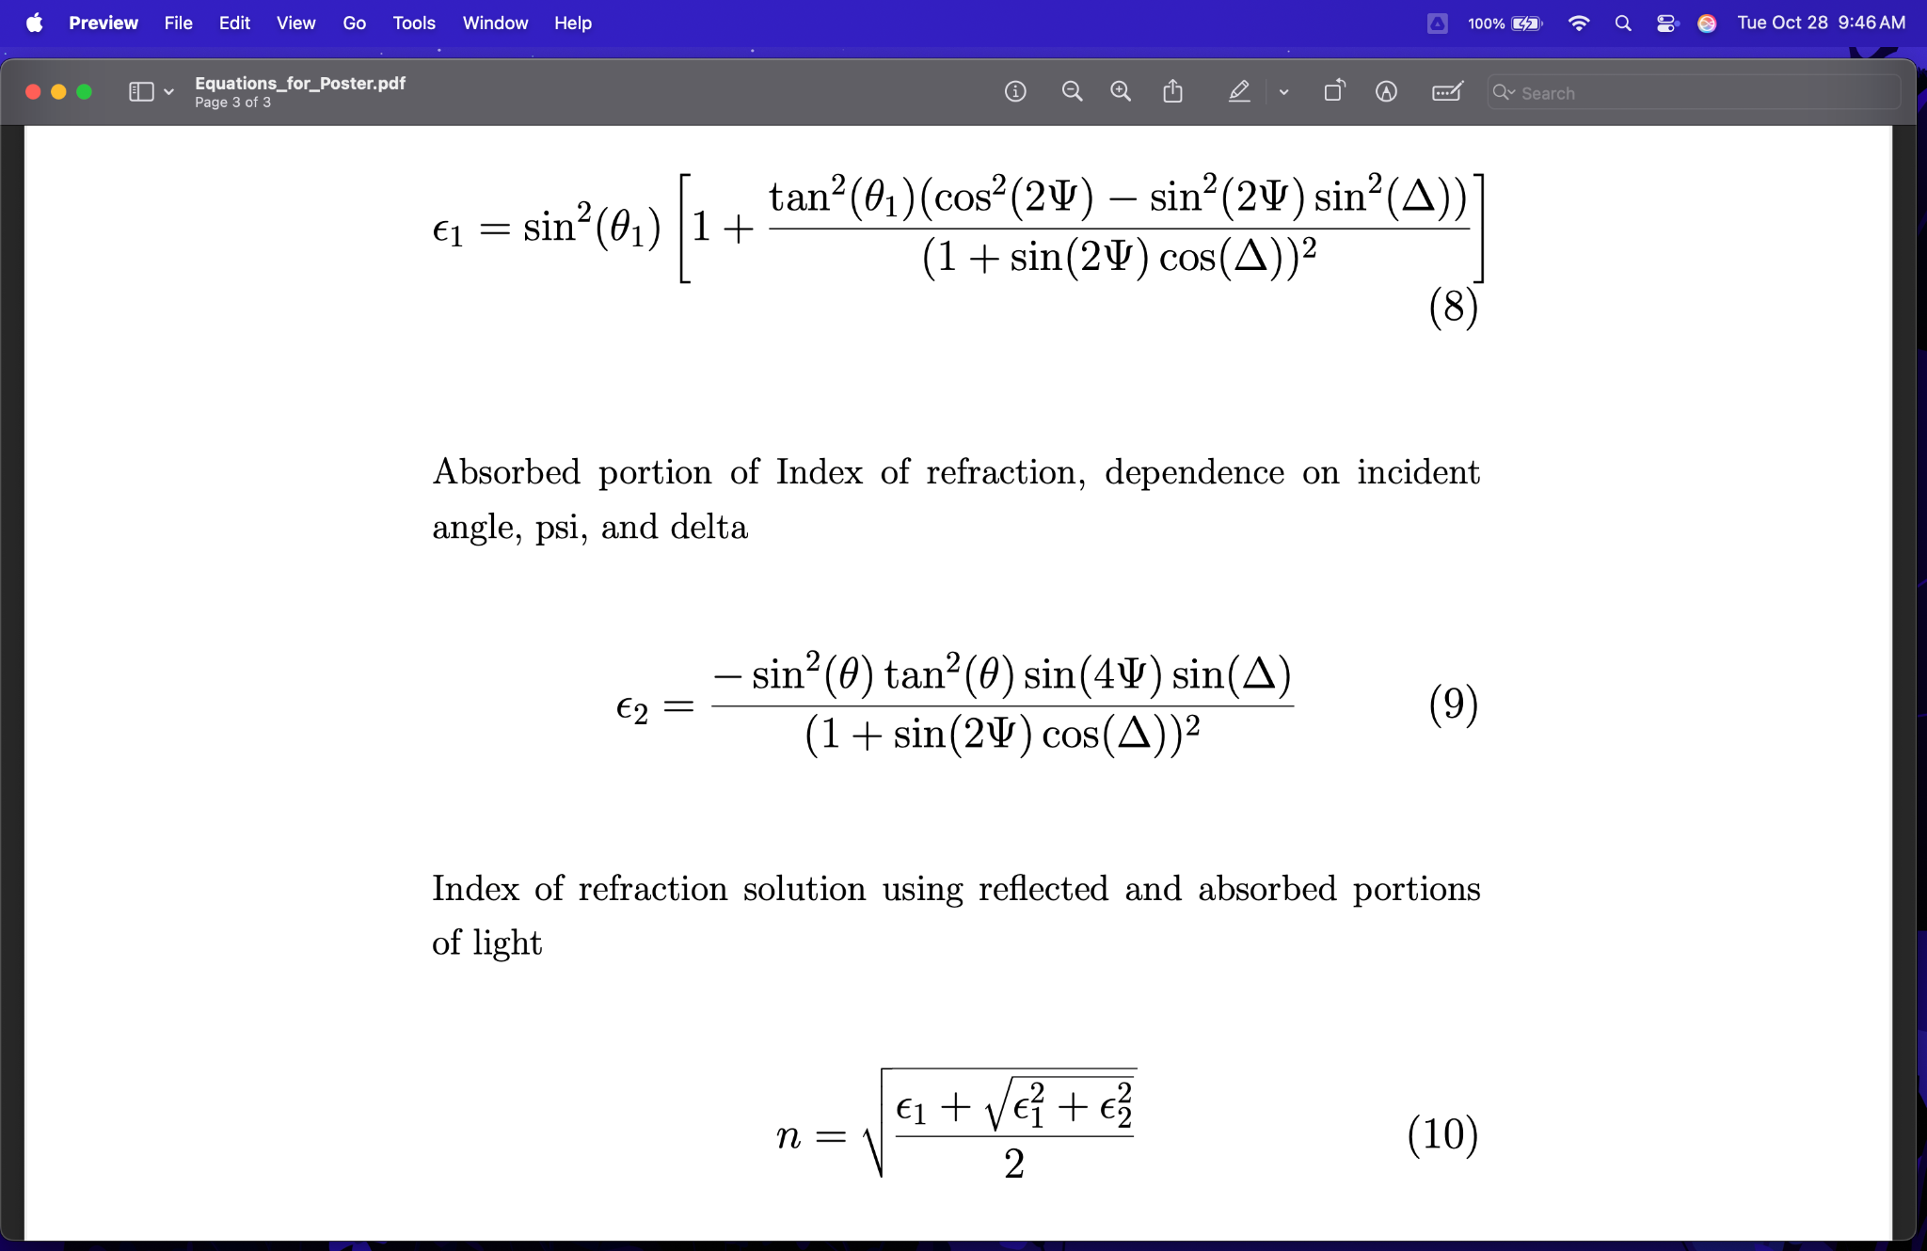
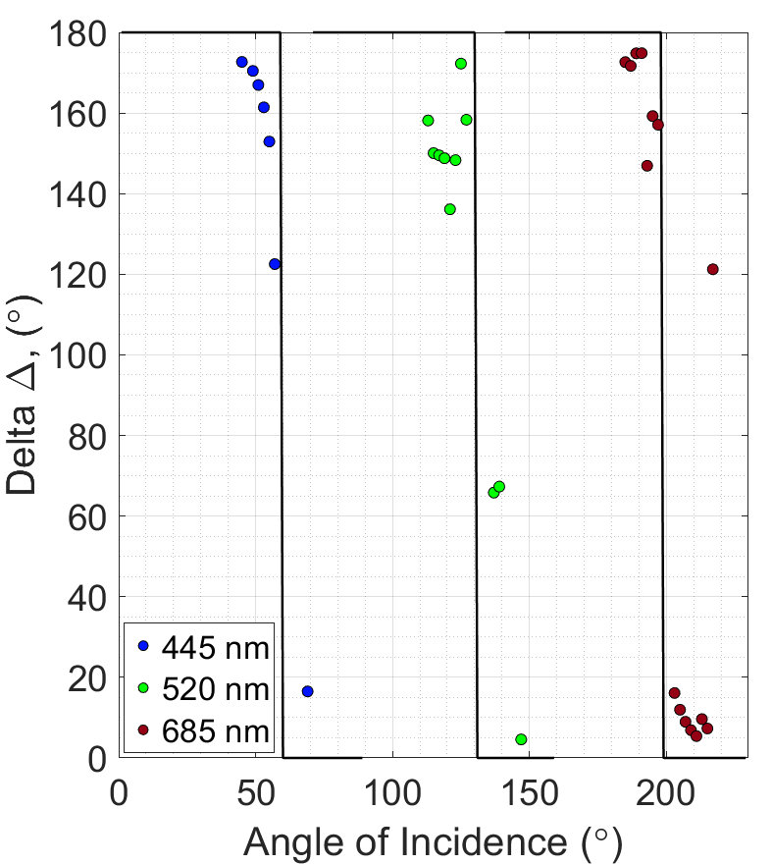
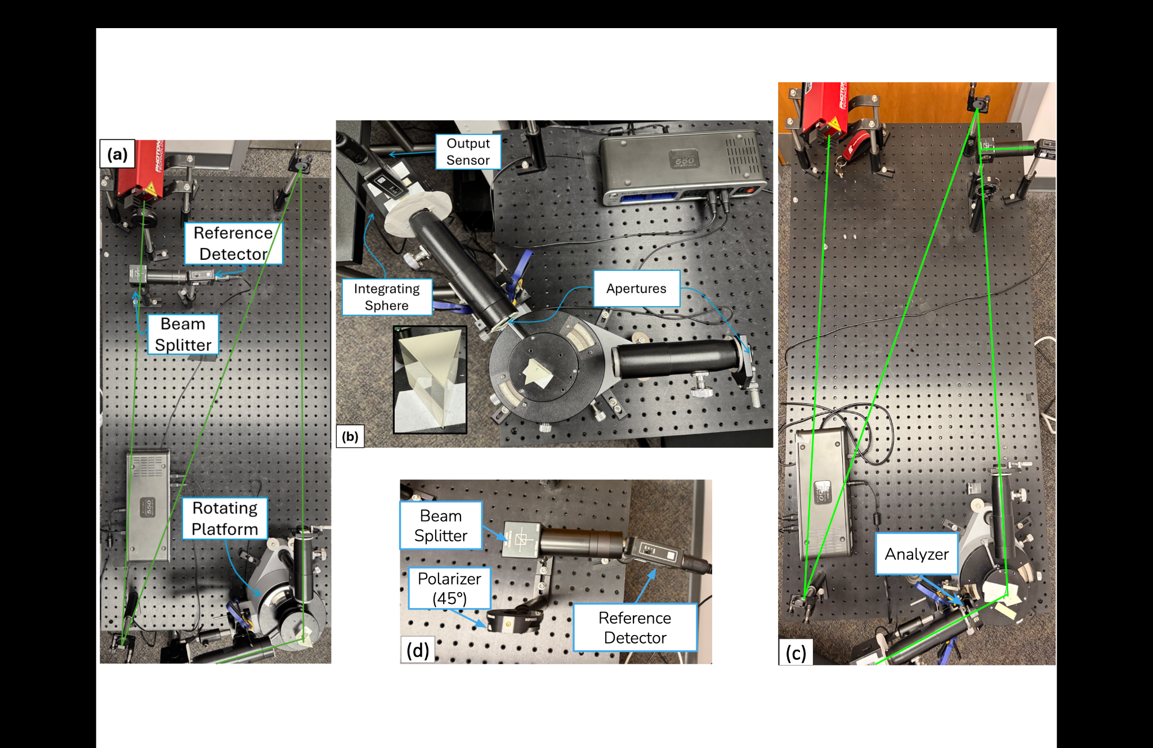
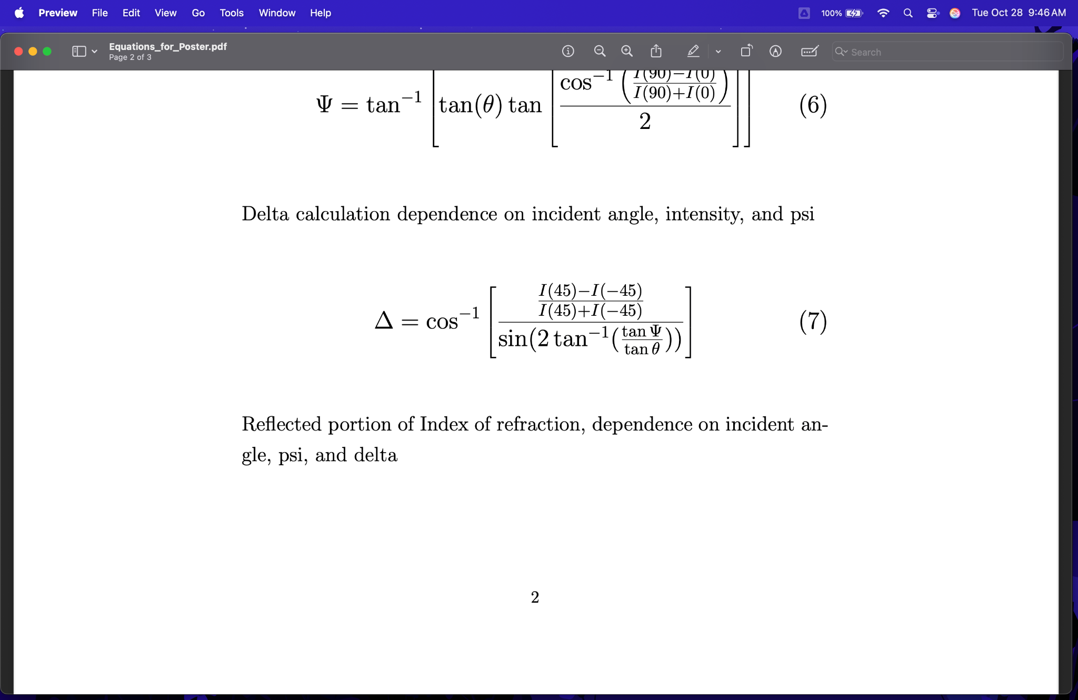
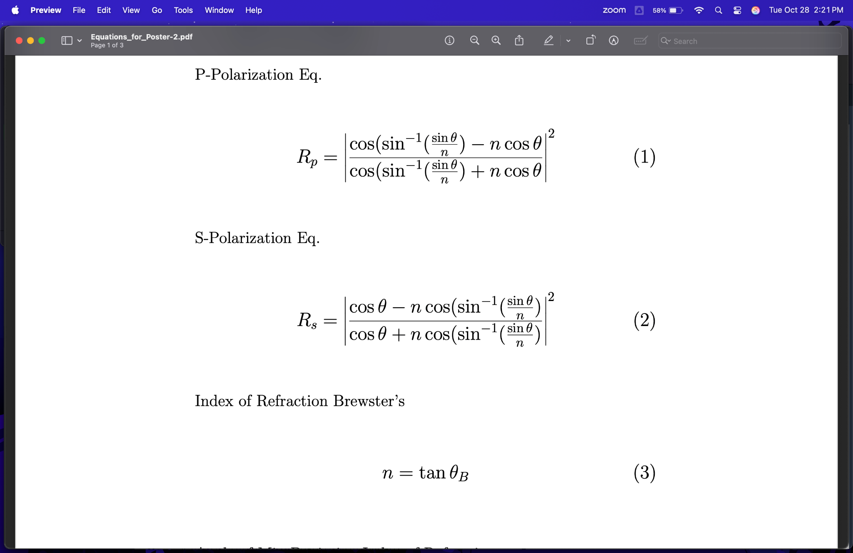
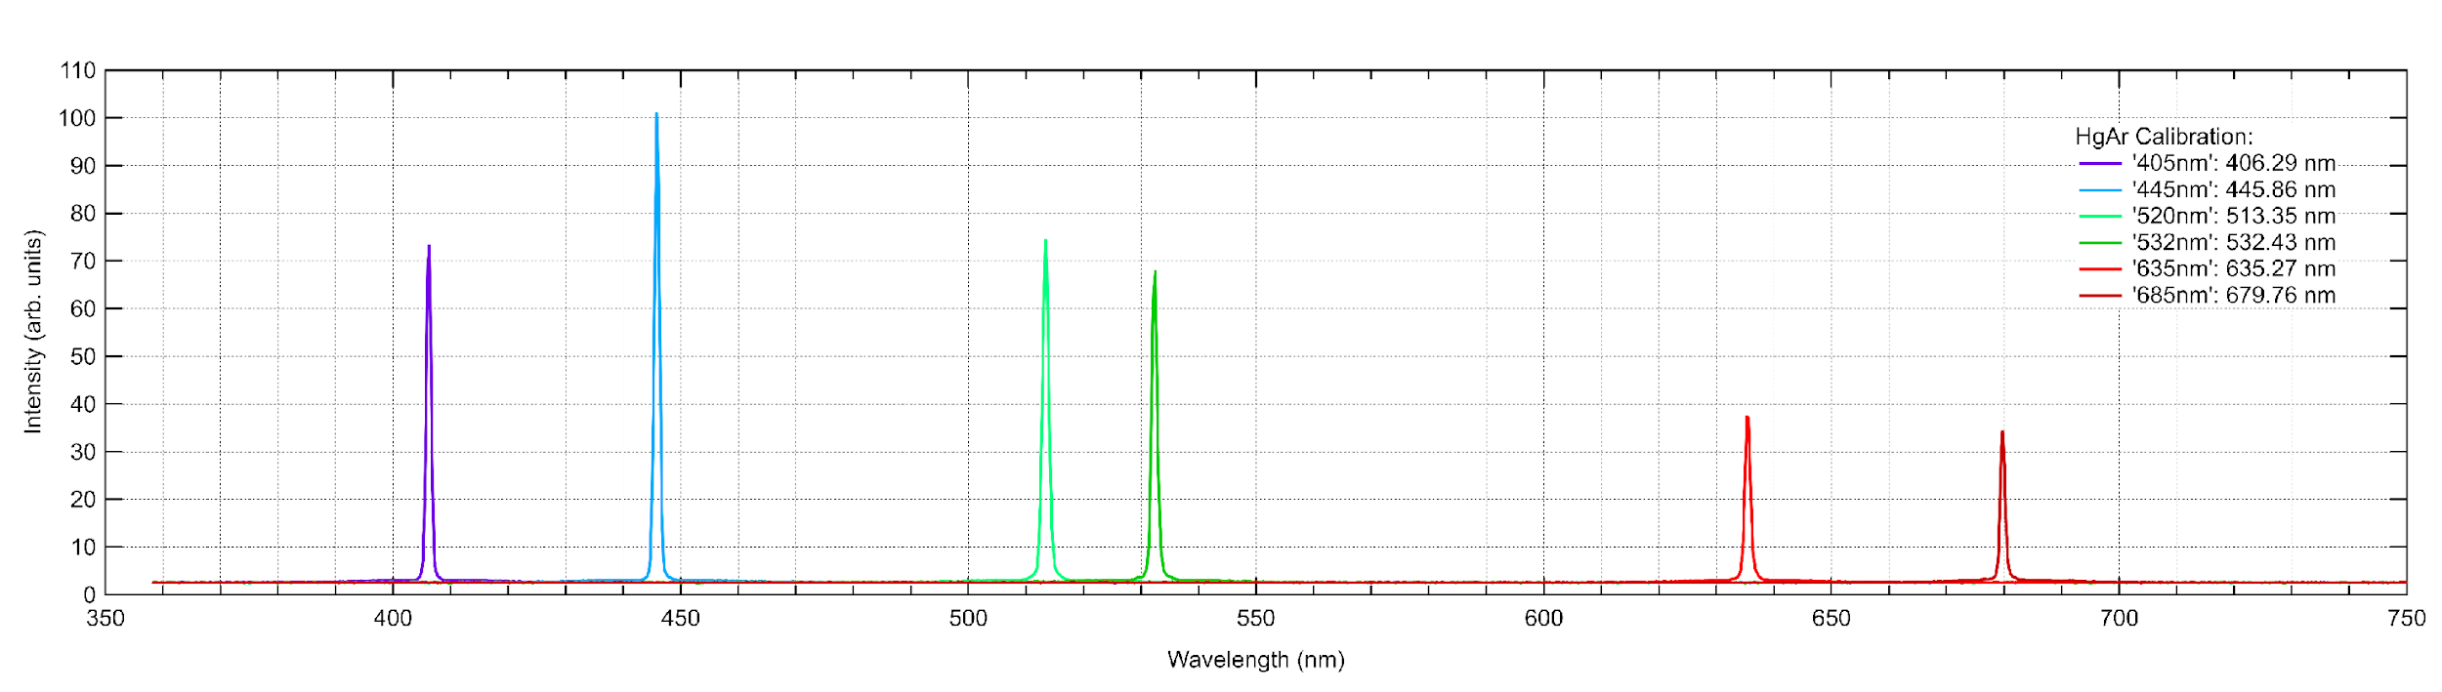
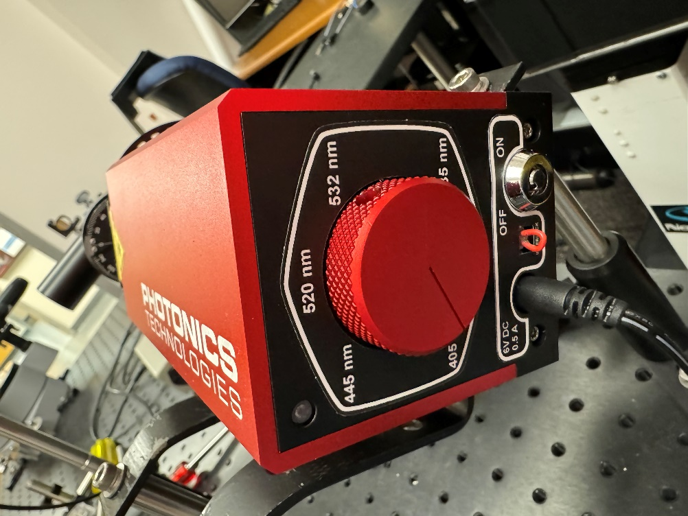
Comparing Five Methods for Determining the Refractive Index of a Glass Prism Using a Multi-Wavelength Laser and a Versatile Optical Setup
,
Thomas Campagna, Keira Scott, Jair Martinez, Michael Graff, and Eugenii U. Donev
Department of Physics, Engineering, and Astronomy, Austin Peay State University, Clarksville, TN 37044, USA
Abstract
We present an update on the progress of our work to include measurements and fits for rotating analyzer ellipsometry to compare with previous methods for determining a glass prism refractive index dispersion, focusing on their accuracy and pedagogical value for undergraduate physics. Methods include minimum deviation, Fresnel reflectance, fitting to the minimum deviation curve, and Brewster’s angle. The angle of minimum deviation was the most accurate (≤0.03% error from Sellmeier values), while the Fresnel method showed the largest inconsistency (0.05%−1.54% error). The minimum deviation fitting results are consistently lower due to a yet unknown systematic error, while the Brewster’s angle results can be made to match by mixing in small fractions of s-polarization. Future steps involve total internal reflection and further research into rotating analyzer ellipsometry (RAE). RAE appears to be a viable, but less accurate method. Furthermore, this method has proven to be very sensitive, where contaminants on our optical surfaces, a slight misalignment of the analyzer, or the prism positioned with an angle offset error of a degree or less, can introduce considerable errors in our results. These experiments and computations can be adapted to various undergraduate projects ranging from a few advanced laboratory sessions to semester-long student research experiences, teaching the importance of precise alignment, calibration, careful measurements, and fitting.
(e)
(f)
Laser, Prism, and Goniometer Setup
We modified the setup for use with two different types of measurements: polarization angle and relative light intensity. For the polarization angle, we analyze the change in the light's polarization state (𝚿 and 𝚫) upon reflection from the bulk substrate using the analyzer. This is achieved by introducing a rotating analyzer after the sample to measure the intensity variations as a function of the analyzer's rotation angle. For the relative light intensity, we measure the reflected intensity for s- and p-polarizations as a function of incident angle. The signal from the rotating detector is normalized against a reference detector (using a beam splitter) to account for laser power fluctuations, yielding the absolute reflectance. Our setup is highly versatile: it utilizes the goniometer for minimum deviation measurements (prism rotation) and is modified for use as a precision reflection table for Fresnel and ellipsometry measurements. It includes an aperture before the prism and an integrating sphere on the output sensor for accurate intensity measurements.
0.7%
s-pol.
0.7% s-pol.
0.6% s-pol.
0.4% s-pol.
0.5% s-pol.
(g)
(I)
(J)
(h)
Results and Conclusions
Equations (1) and (2) show the relationship between the reflectance of p-polarized and s-polarized light (R_{p} and R_{s}), the incident angle (𝜃), and the refractive index (n). Equation (3) describes the relationship between refractive index and Brewster’s angle (𝜃_{B}), where Brewster’s angle is the incident angle at which the reflectance of p-polarized light is at a minimum. Equation (4) relates the refractive index of a prism to the angle of the prism (A), and the angle of minimum deviation (𝛿_{m}), which is the angle where the refracted beam deviates least relative to the incident beam. Equation (5) shows the dependence of the deviation angle (𝛿) on the incident angle, refractive index, and angle of the prism. Recent additions to research introduce the Rotating Analyzer Ellipsometry (RAE) method. Equations (6) through (10) model RAE through calculating the parameters 𝛹 (Psi) and 𝛥 (Delta) from incident angle and intensity, which are then used to solve for the refractive index.
As seen in Figure (f), our results support that the method of calculating the refractive index of a prism by finding the angle of minimum deviation and using Equation (4) is comparatively more accurate and precise, showing excellent agreement with the Sellmeier fit. The Sellmeier equation shows the dispersion of the refractive index with respect to wavelength. Figure (h) displays the measurements for s- and p-polarized light as well as the theoretical reflectance curves for a 520 nm beam using Equations (1) and (2) as well as the effect of a slight inclusion of s-polarized light at Brewster’s angle, and therefore refractive index. Our results show a ~ 0.5% s-polarization component in the laser when p-polarized, which is near the extinction coefficient of the polarizer. This can explain the refractive index difference, as illustrated in Figure (g). Figure (e) shows the measured values for deviation angle for each wavelength of the laser and curve fits that were found with MATLAB using Equation (5); however, a systematic error causing consistently lower minimum deviation curve fits is still being investigated.
The newly explored RAE method was found to be a viable but less accurate and extremely sensitive method. Comparing the index of refraction (n) values solved using our collected RAE data with the Sellmeier values shows considerable percentage errors:
Previous conclusions still hold regarding minimum deviation being the most accurate and precise method. Future work includes exploring the discrepancy between deviation angle and curve fit shown in Figure (e), experimentally determining the minimum percentage of s-polarization in our setup, further characterizing the performance of RAE, and incorporating additional research into Total Internal Reflection (TIR).
(e)
(a)
(b)
Figure (a) shows the path of the laser for measuring Brewster’s angle, with a polarizer, beam splitter and reference detector, goniometer, and signal detector. Figure (b) shows the prism configuration for measuring the angle of minimum deviation with an inset of the prism. Figure (c) shows the configuration for rotating analyzer ellipsometry using the goniometer as a reflection table, with the analyzer placed before the signal detector. Figure (d) illustrates the use of the beam splitter to direct light to the reference detector for laser power normalization. Figure (e) shows the spectra of each of the 6 wavelengths along with a photo of the six-wavelength laser.
Comparison of Index of Refraction from Experimental Ellipsometry to Expected Values from Sellmeier Equation
Wavelength (nm) | Excel Solver n value | Sellmeier n value | % error n
445 | 1.7037 | 1.7583 | 3.11
520 | 1.7603 | 1.7403 | 1.15
685 | 1.6609 | 1.7188 | 3.37
References and Acknowledgements
[1] J. Peatross and M. Ware. Physics of Light and Optics, 2015 edition. BYU. (2016).
[2] E. Hecht. Optics, 5th edition. Adelphi University, Pearson. (2017).
[3] Matthew Mantia, Teresa Bixby; Optical measurements on a budget: A 3D-printed ellipsometer. Am. J. Phys. (2022).
We gratefully acknowledge the SPS Con travel grant for providing funding for travel to this conference, Bryan Gaither for his assistance in assembling our setup, and William Keener for his help in gathering data.

